Slide 1
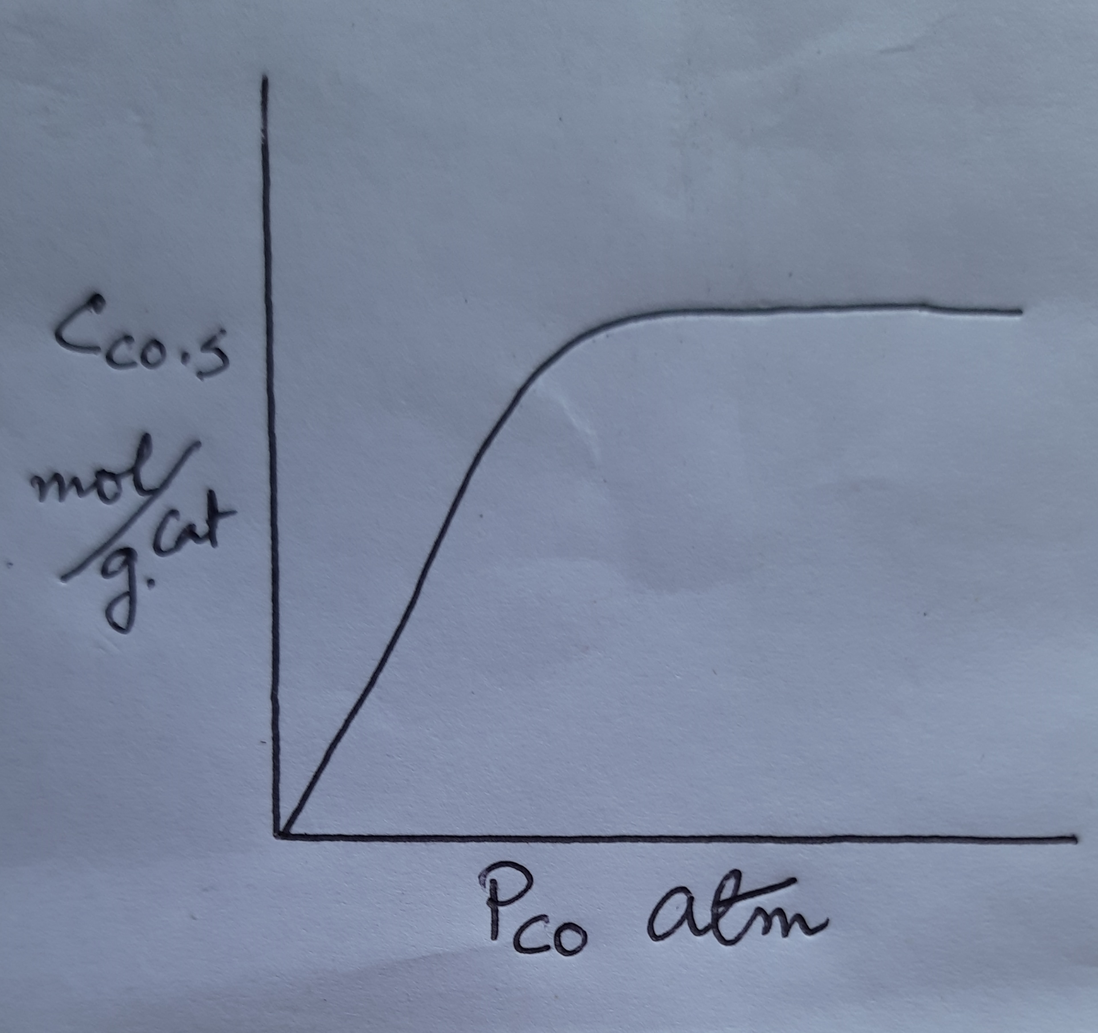
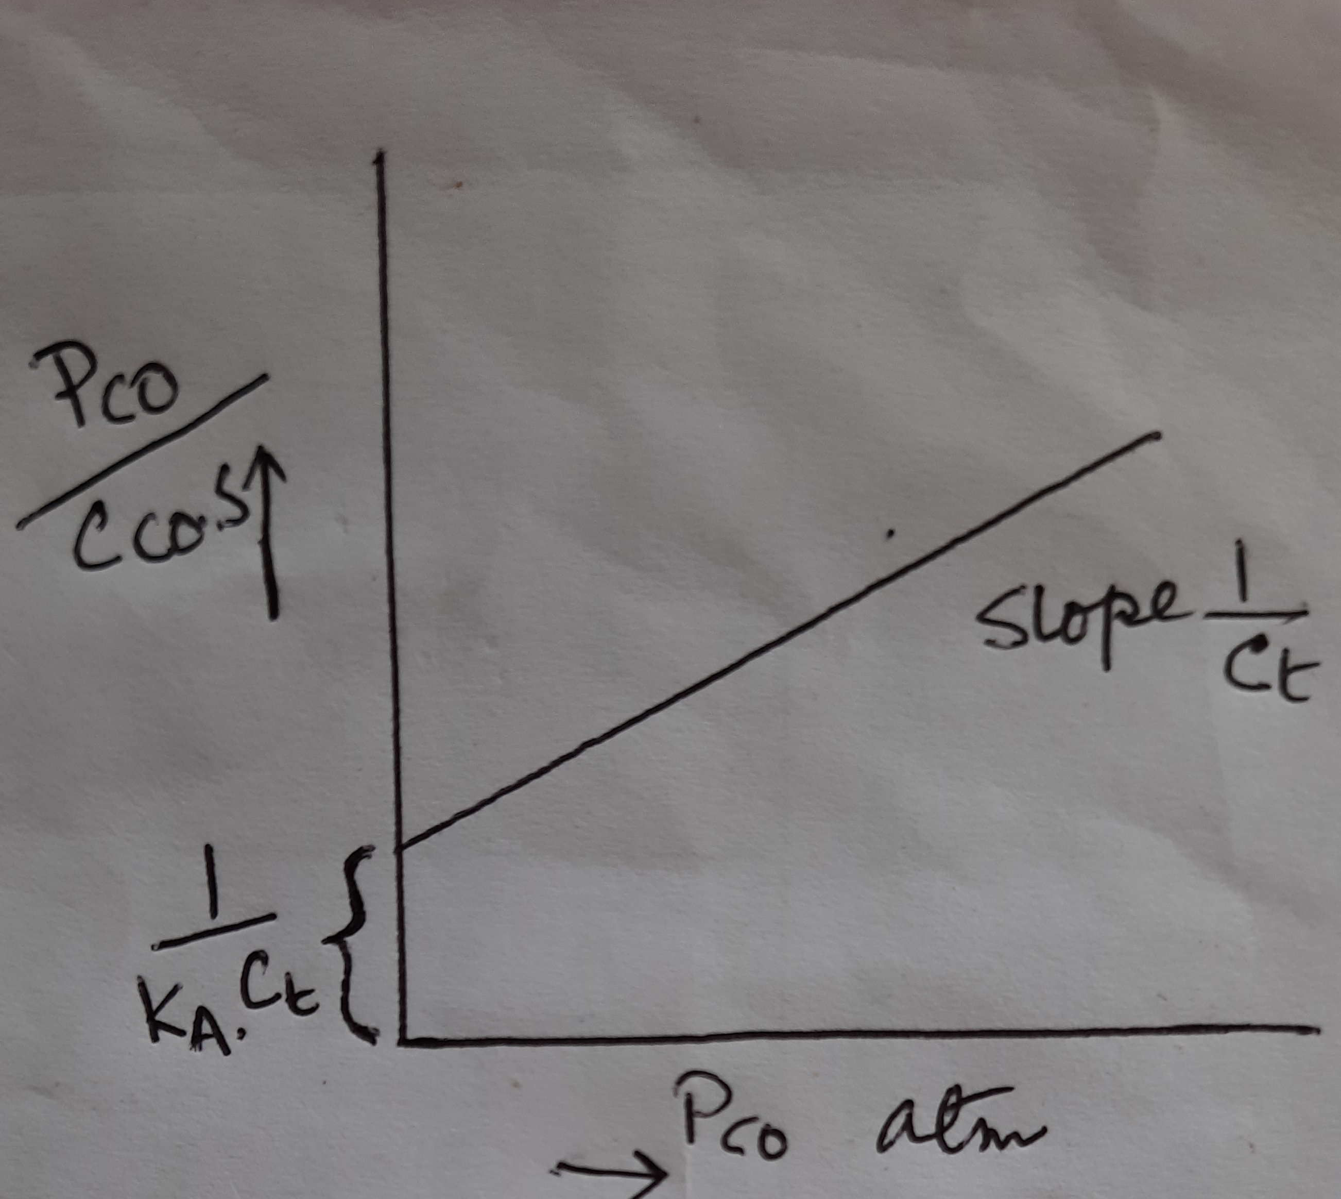
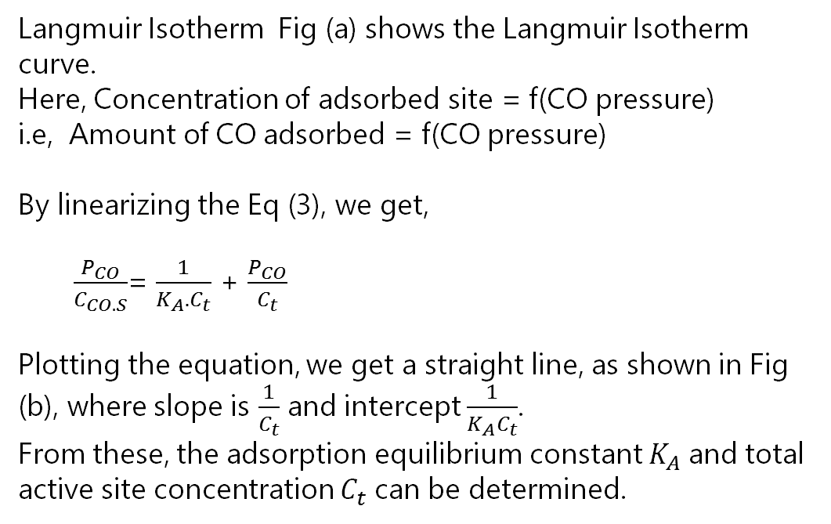
Contd…
Langmuir Isotherm Fig (a) shows the Langmuir Isotherm curve.
Here, Concentration of adsorbed site = f(CO pressure)
i.e, Amount of CO adsorbed = f(CO pressure)
By linearizing the Eq (3), we get,
$\frac{P_{CO}}{C_{CO.S}}$= $\frac{1}{K_{A}.C_{t}}$ + $\frac{P_{CO}}{C_{t}}$
Plotting the equation, we get a straight line, as shown in Fig (b), where slope is $\frac{1}{C_{t}}$ and intercept $\frac{1}{K_{A}C_{t}}$.
From these, the adsorption equilibrium constant $K_{A}$ and total active site concentration $C_{t}$ can be determined.
a
b

Slide 2
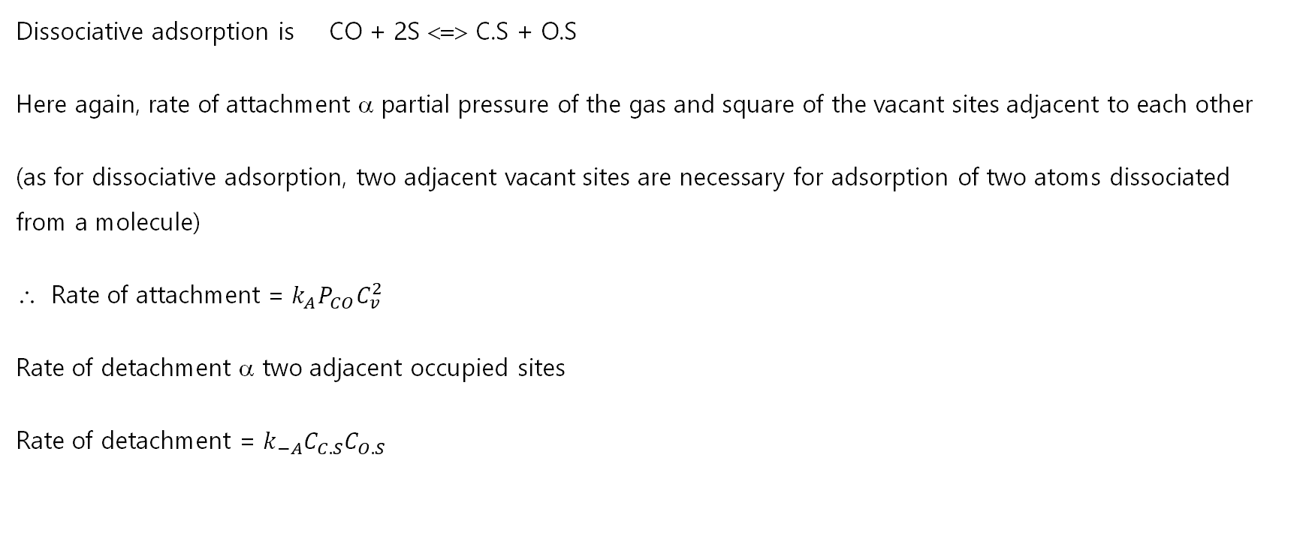
Dissociative adsorption
Dissociative adsorption is CO + 2S <=> C.S + O.S
Here again, rate of attachment α partial pressure of the gas and square of the vacant sites adjacent to each other
(as for dissociative adsorption, two adjacent vacant sites are necessary for adsorption of two atoms dissociated from a molecule)
Rate of attachment = $k_{A}P_{CO}C_{v}^{2}$
Rate of detachment α two adjacent occupied sites
Rate of detachment = $k_{−A}C_{C.S}C_{O.S}$

Slide 3

Contd…
Total rate of adsorption is,
$r_{AD}$= $k_{A}P_{CO}C_{v}^{2}$ − $k_{−A}C_{C.S}C_{O.S}$
= $k_{A}{ (P}_{CO}C_{v}^{2}$ − $\frac{C_{C.S}C_{O.S}}{K_{A}}$), $K_{A}$= $\frac{k_{A}}{k_{−A}}$ = adsorption equilibrium constant.
For dissociative adsorption, $k_{−A}$ will increase with increase in temperature. So, $K_{A}$ will decrease with temperature.
At equilibrium, ${ P}_{CO}C_{v}^{2}$= $\frac{C_{C.S}C_{O.S}}{K_{A}}$
If, $C_{C.S}$= $C_{O.S}$, then, ${ P}_{CO}C_{v}^{2}K_{A}$=$C_{O.S}^{2}$ ∴ $C_{O.S}$= ($P_{CO}K_{A}$)^{1/2} $C_{v}$------(4)

Slide 4
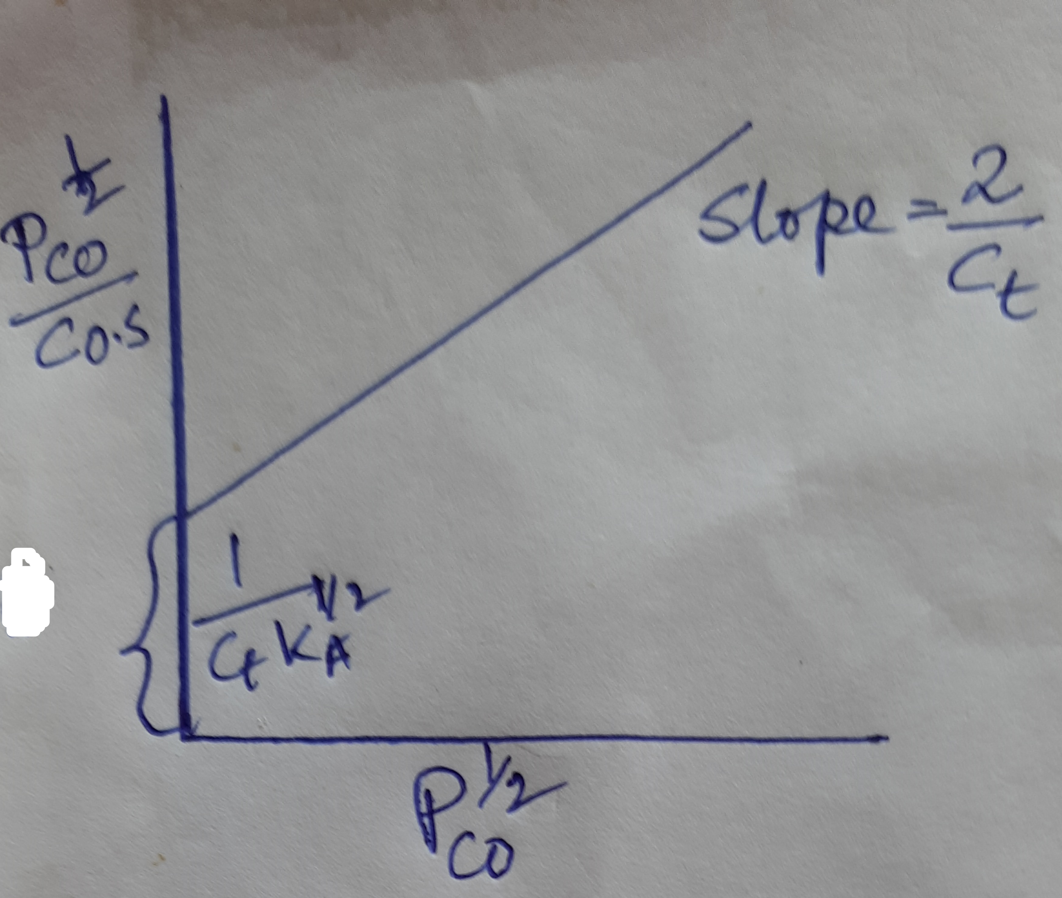

Contd…
For site balance, $C_{t}$= $C_{v}$+$C_{C.S}+C_{O.S}$ or, ${ C}_{v}$= $C_{t}$−2$C_{O.S}$
Putting the value of $C_{v}$ in Eq. (4), $C_{O.S}$ = ($P_{CO}K_{A}$)^{1/2} ($C_{t}$−2$C_{O.S}$)
Solving, $C_{O.S}$= $\frac{C_{t }\text{(}P_{CO}K_{A}\text{)}\text{1/2}}{1+2\text{(}P_{CO}K_{A}\text{)}\text{1/2}}$
Linearising, $\frac{1}{C_{O.S}}$= $\frac{1}{C_{t }\text{(}P_{CO}K_{A}\text{)}\text{1/2}}$ + $\frac{2}{C_{t}}$
Fig (C) shows the plot.
(C)

Slide 5
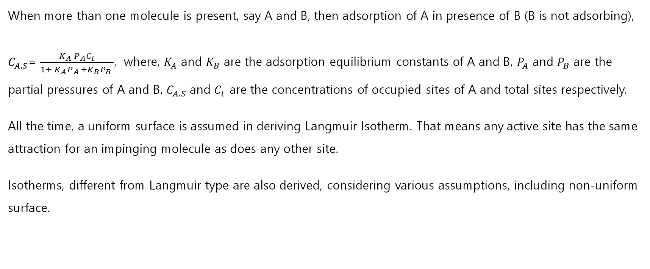
Contd…
When more than one molecule is present, say A and B, then adsorption of A in presence of B (B is not adsorbing),
$C_{A.S}$= $\frac{K_{A} P_{A}C_{t}}{1+ K_{A}P_{A }+K_{B}P_{B} }$, where, $K_{A}$ and $K_{B}$ are the adsorption equilibrium constants of A and B, $P_{A}$ and $P_{B}$ are the partial pressures of A and B, $C_{A.S}$ and $C_{t}$ are the concentrations of occupied sites of A and total sites respectively.
All the time, a uniform surface is assumed in deriving Langmuir Isotherm. That means any active site has the same attraction for an impinging molecule as does any other site.
Isotherms, different from Langmuir type are also derived, considering various assumptions, including non-uniform surface.

